Slide 1
The 8051 Microcontroller and Embedded Systems
CHAPTER 14
8051 INTERFACING TO EXTERNAL MEMORY
vignan university

Slide 2
OBJECTIVES
Contrast and compare various types of semiconductor memories in terms of their capacity, organization, and access time
Describe the relationship between the number of memory locations on a chip, the number of data pins, and the chip capacity
Define ROM memory and describe its use in 8051-based systems
Contrast and compare PROM, EPROM, UV EPROM, EEPROM, flash memory EPROM, and mask ROM memories
Define RAM memory and describe its use in 8051-based systems
Contrast and compare SRAM, NV-RAM, checksum byte, and DRAM memories
List the steps a CPU follows in memory address decoding
Explain how to interface ROM with the 8031/51
Explain how to use both on-chip and off-chip memory with the 8051
Code 8051 Assembly programs accessing the 64K-byte data memory space
vignan university

Slide 3
SECTION 14.1: SEMICONDUCTOR MEMORY
Memory capacity
The number of bits that a semiconductor memory chip can store is called chip capacity.
It can be in units of Kbits (kilobits), Mbits (megabits), and so on.
vignan university

Slide 4
SECTION 14.1: SEMICONDUCTOR MEMORY
Memory organization
Memory chips are organized into a number of locations within the IC.
Each location can hold 1 bit, 4 bits, 8 bits, or even 16 bits, depending on how it is designed internally.
vignan university

Slide 5
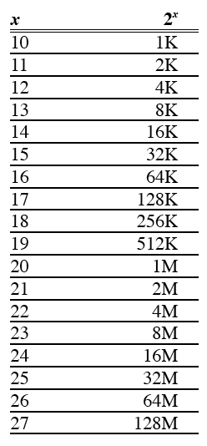
SECTION 14.1: SEMICONDUCTOR MEMORY
Speed
The speed of the memory chip
is commonly referred to as
its access time.
The access time of memory chips
varies from a few nanoseconds to
hundreds of nanoseconds,
depending on the IC technology
used in the design and
abrication process.
Table 14–1 Powers of 2
vignan university

Slide 6
SECTION 14.1: SEMICONDUCTOR MEMORY
ROM (read-only memory)
ROM is a type of memory that does not lose its contents when the power is turned off.
For this reason, ROM is also called nonvolatile memory.
vignan university

Slide 7
SECTION 14.1: SEMICONDUCTOR MEMORY
PROM (programmable ROM) and OTP
PROM is programmed by blowing the fuses.
If the information burned into PROM is wrong, that PROM must be discarded since its internal fuses are blown permanently.
vignan university

Slide 8
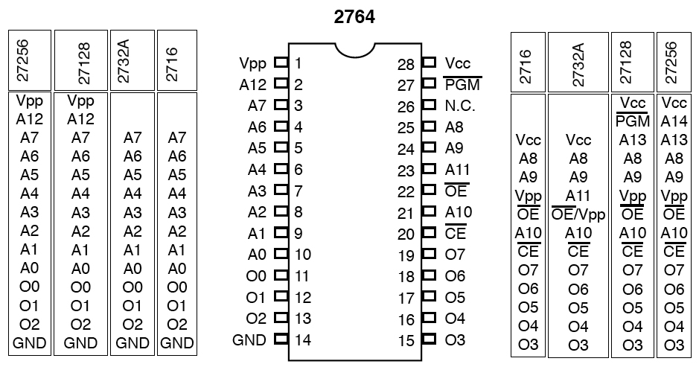
SECTION 14.1: SEMICONDUCTOR MEMORY
EPROM (erasable programmable ROM) and UV-EPROM
vignan university
Figure 14–1 Pin Configurations for 27xx ROM Family

Slide 9
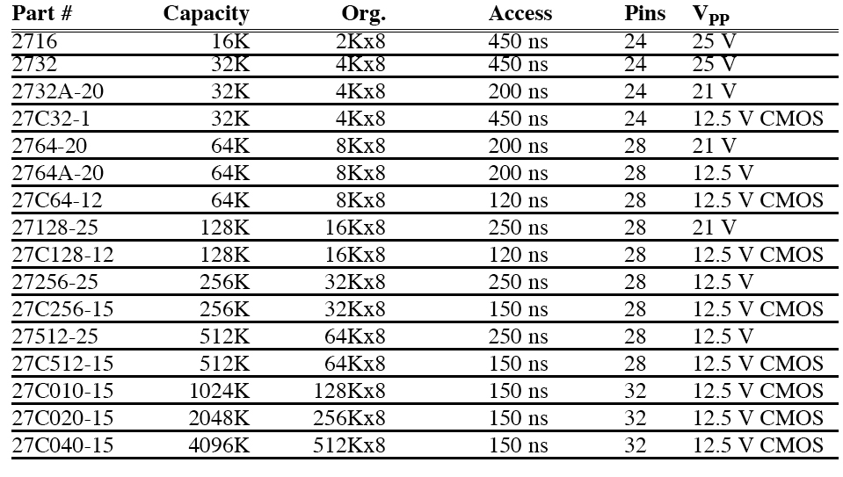
SECTION 14.1: SEMICONDUCTOR MEMORY
Table 14–2 Some UV-EPROM Chips
vignan university

Slide 10
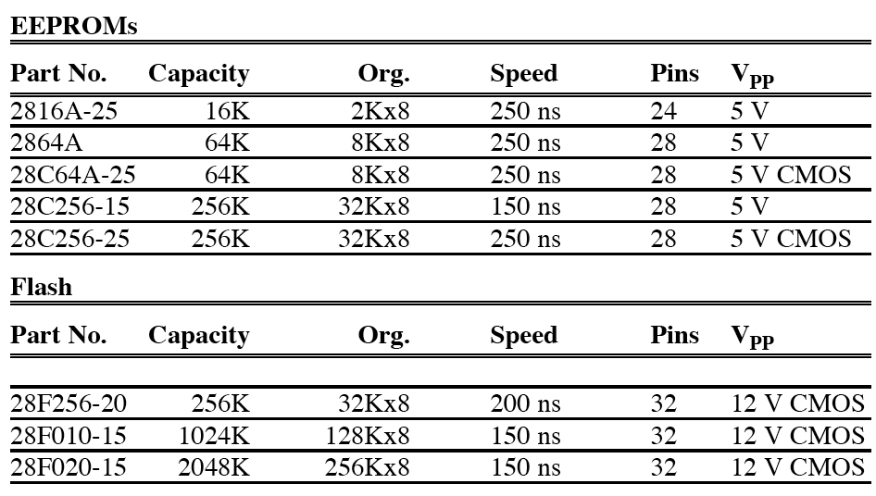
SECTION 14.1: SEMICONDUCTOR MEMORY
EEPROM (electrically erasable programmable ROM)
vignan university
Table 14–3 Some EEPROM and Flash Chips

Slide 11
SECTION 14.1: SEMICONDUCTOR MEMORY
Flash memory EPROM
flash memory can be programmed while it is in its socket on the system board, it is widely used to upgrade the BIOS ROM of the PC.
flash memory is semiconductor memory with access time in the range of 100 ns compared with disk access time in the range of tens of milliseconds.
vignan university

Slide 12
SECTION 14.1: SEMICONDUCTOR MEMORY
Mask ROM
Mask ROM refers to a kind of ROM in which the contents are programmed by the IC manufacturer.
Mask ROM is used when the needed volume is high (hundreds of thousands) and it is absolutely certain that the contents will not change.
vignan university

Slide 13
SECTION 14.1: SEMICONDUCTOR MEMORY
RAM (random access memory)
RAM memory is called volatile memory since cutting off the power to the IC results in the loss of data.
vignan university

Slide 14
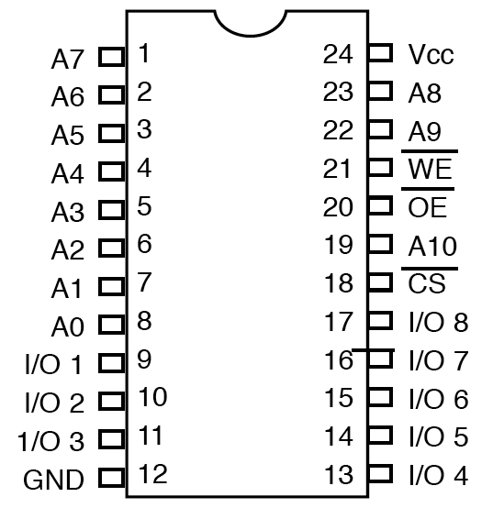
SECTION 14.1: SEMICONDUCTOR MEMORY
SRAM (static RAM)
Storage cells in static
RAM memory are
made of flip-flops
and therefore do
not require refreshing
in order to keep
their data.
This is in contrast
to DRAM.
Figure 14–2
2Kx8 SRAM Pins
vignan university

Slide 15
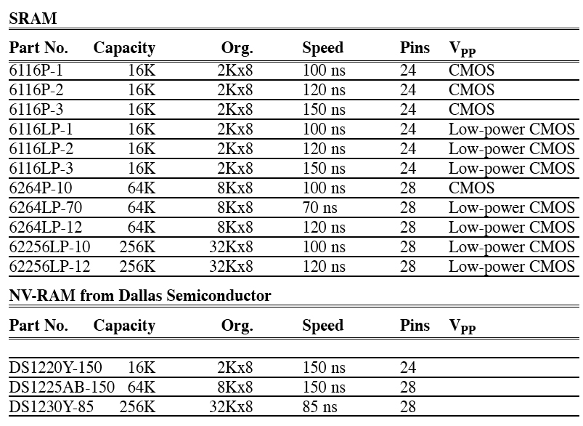
SECTION 14.1: SEMICONDUCTOR MEMORY
Table 14–4 Some SRAM and NV-RAM Chips
vignan university

Slide 16
SECTION 14.1: SEMICONDUCTOR MEMORY
NV-RAM (nonvolatile RAM)
New type of nonvolatile RAM called NV-RAM.
Like other RAMS, it allows the CPU to read and write to it, but when the power is turned off the contents are not lost.
vignan university

Slide 17
SECTION 14.1: SEMICONDUCTOR MEMORY
Checksum byte ROM
checksum will detect any corruption of the contents of ROM
vignan university

Slide 18
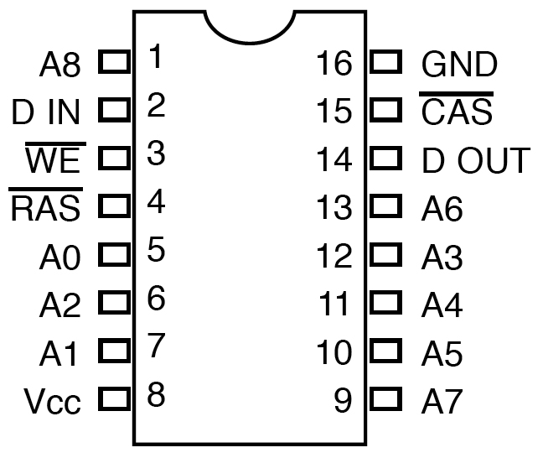
SECTION 14.1: SEMICONDUCTOR MEMORY
DRAM (dynamic RAM)
uses a capacitor to
store each bit
requires constant
refreshing due to
leakage
Figure 14–3 256Kx1 DRAM
vignan university

Slide 19
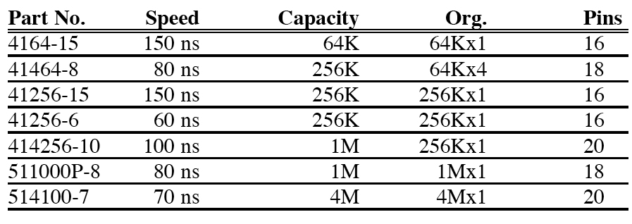
SECTION 14.1: SEMICONDUCTOR MEMORY
vignan university

Slide 20
SECTION 14.1: SEMICONDUCTOR MEMORY
Packaging issue in DRAM
In DRAM there is a problem of packing a large number of cells into a single chip with the normal number of pins assigned to addresses
vignan university

Slide 21
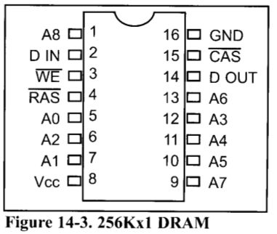
SECTION 14.1: SEMICONDUCTOR MEMORY
DRAM organization
vignan university

Slide 22
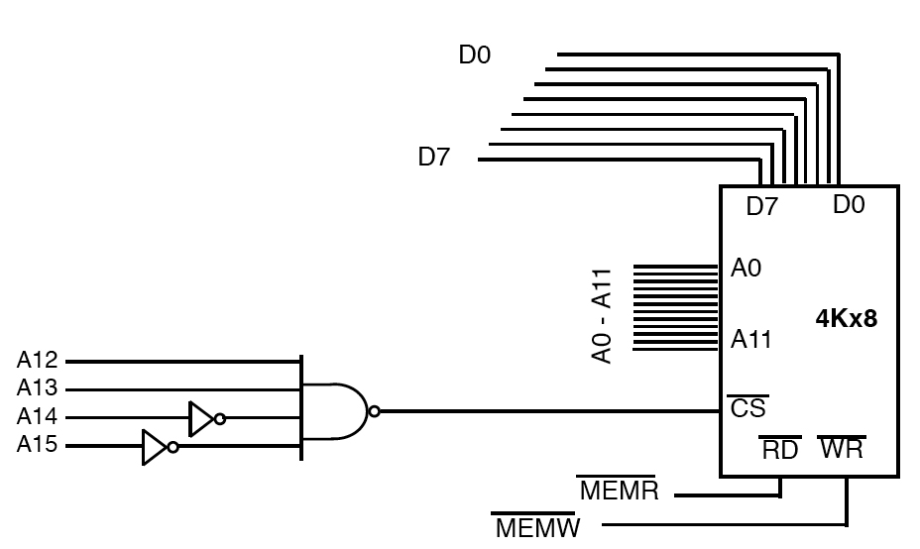
SECTION 14.2: MEMORY ADDRESS DECODING
Simple logic gate address decoder
Figure 14–4 Logic Gate as Decoder
vignan university

Slide 23
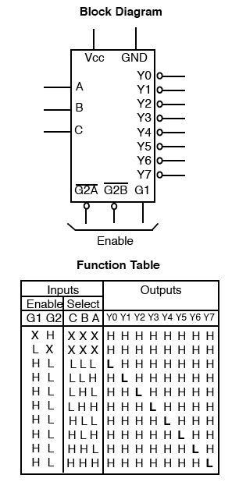
SECTION 14.2: MEMORY ADDRESS DECODING
Using the 74LS138 3-8 decoder
Figure 14–5
74LS138 Decoder
(Reprinted by permission of Texas Instruments,
Copyright Texas Instruments, 1988)
vignan university

Slide 24
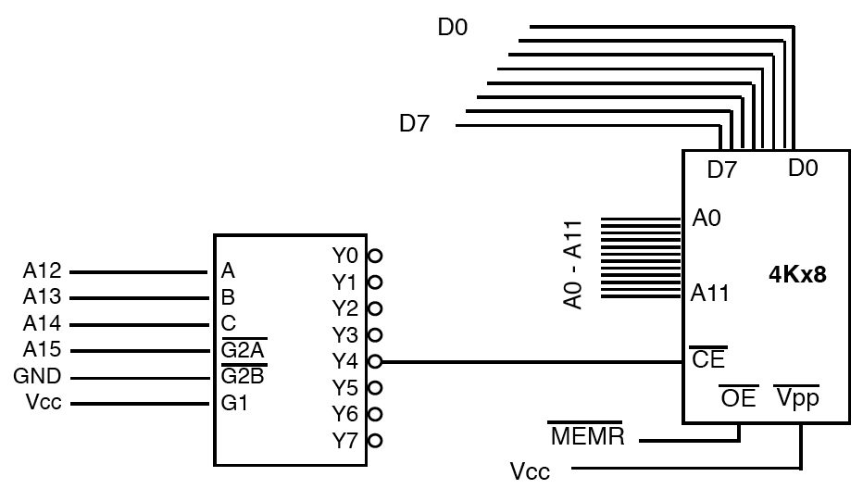
SECTION 14.2: MEMORY ADDRESS DECODING
Figure 14–6 74LS138 as Decoder
vignan university

Slide 25
SECTION 14.2: MEMORY ADDRESS DECODING
Using programmable logic as an address decoder
The advantage of these chips is that they can be programmed for any combination of address ranges, and so are much more versatile.
PALs and GALS have 10 or more inputs (in contrast to 6 in the 74138) means that they can accommodate more address inputs.
vignan university

Slide 26
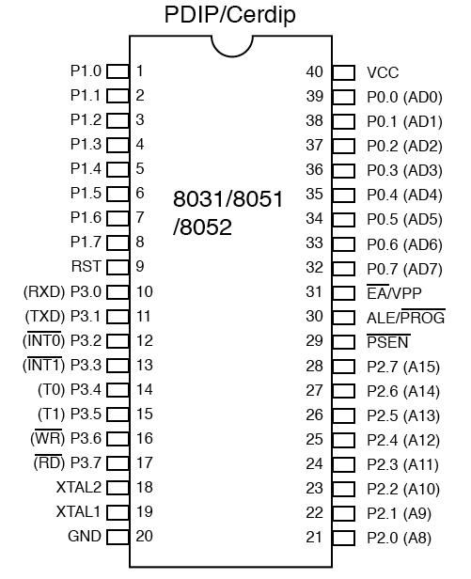
SECTION 14.3: 8031/51 INTERFACING WITH EXTERNAL ROM
EA pin
Connect the EA pin
to Vcc to indicate that
the program code is
stored in the μC's
on-chip ROM.
To indicate that the program
code is stored in external ROM,
this pin must be connected
to GND.
Figure 14–7 8051 Pin Diagram
vignan university

Slide 27
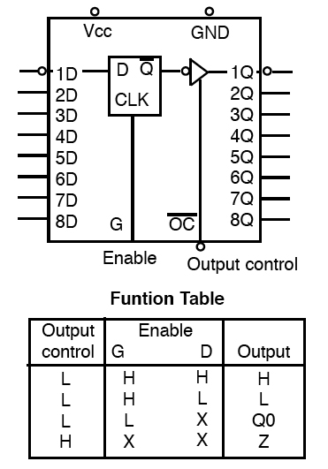
SECTION 14.3: 8031/51 INTERFACING WITH EXTERNAL ROM
Figure 14–8
74LS373 D Latch
(Reprinted by permission of Texas Instruments,
Copyright Texas Instruments, 1988)
vignan university

Slide 28
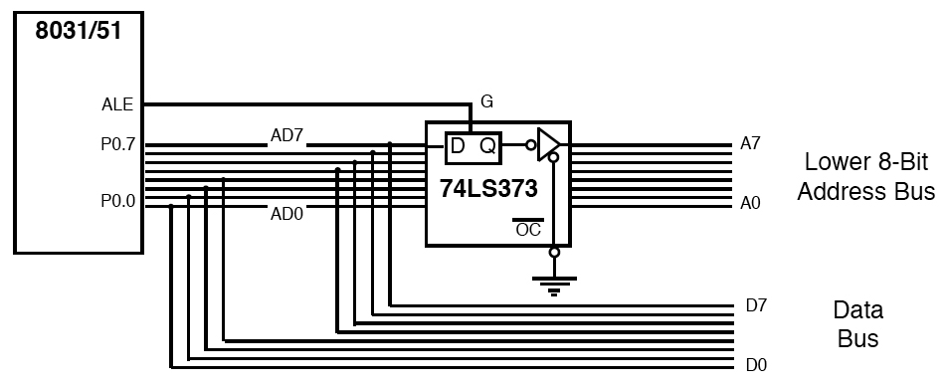
SECTION 14.3: 8031/51 INTERFACING WITH EXTERNAL ROM
P0 and P2 role in providing addresses
Figure 14–9 Address/Data Multiplexing
vignan university

Slide 29
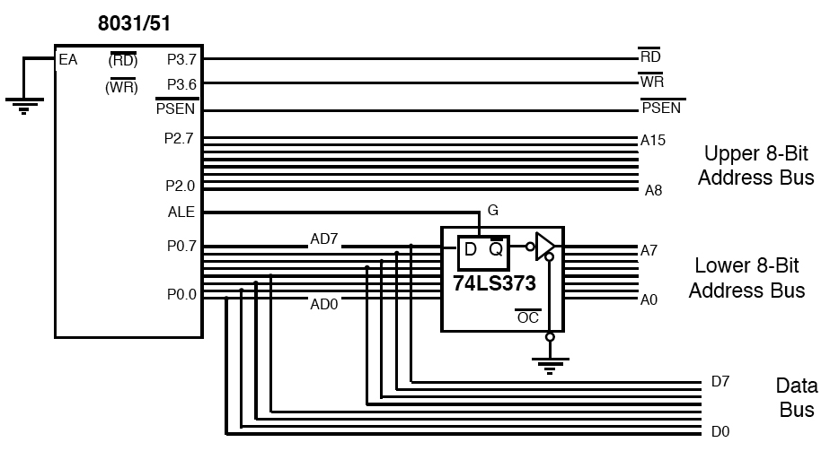
SECTION 14.3: 8031/51 INTERFACING WITH EXTERNAL ROM
vignan university
Figure 14–10 Data, Address, and Control Buses for the 8031

Slide 30
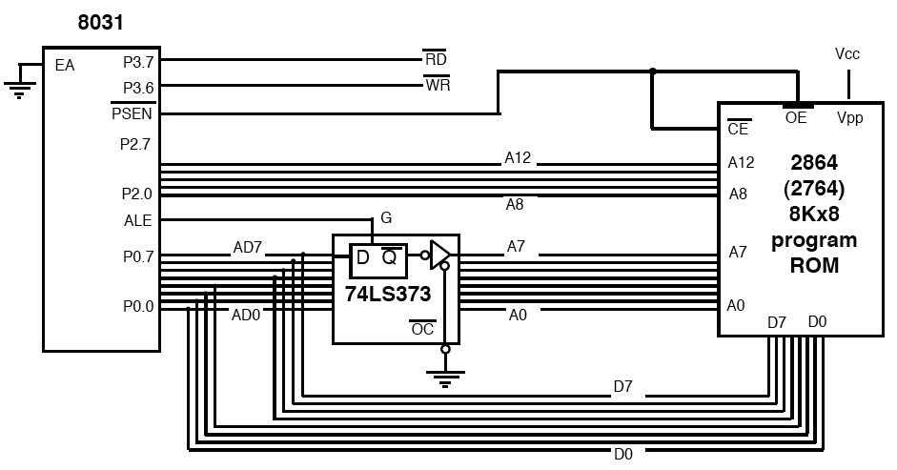
SECTION 14.3: 8031/51 INTERFACING WITH EXTERNAL ROM
Figure 14–11 8031 Connection to External Program ROM
vignan university

Slide 31
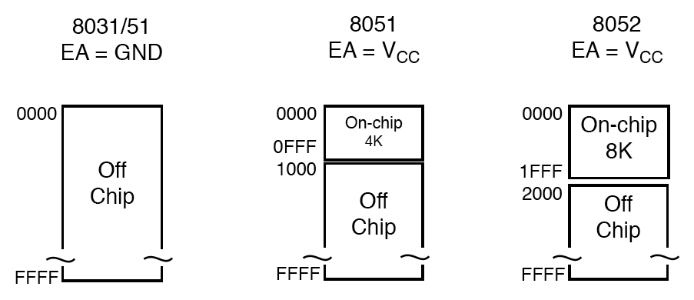
SECTION 14.3: 8031/51 INTERFACING WITH EXTERNAL ROM
PSEN
Figure 14–12 On-chip and Off-chip Program Code Access
vignan university

Slide 32
SECTION 14.3: 8031/51 INTERFACING WITH EXTERNAL ROM
On-chip and off-chip code ROM
In such a system we still have EA = Vcc, meaning that upon reset the 8051 executes the on-chip program first; then, when it reaches the end of the on-chip ROM it switches to external ROM for the rest of the program code.
vignan university

Slide 33
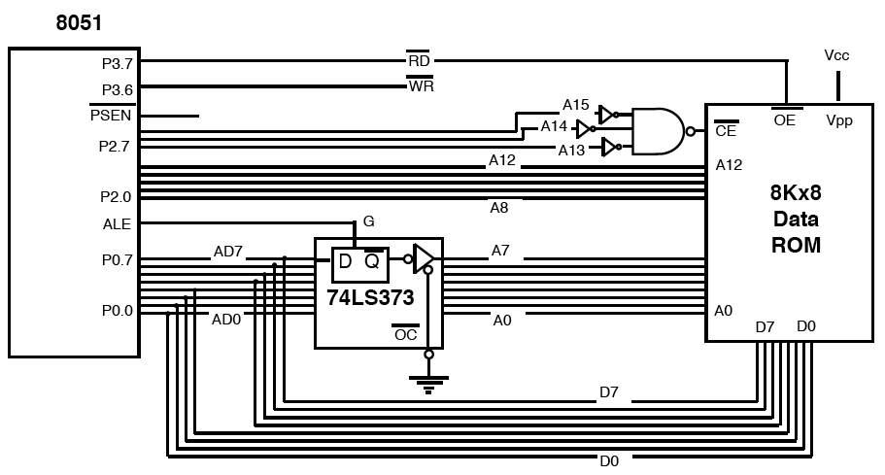
SECTION 14.4: 8051 DATA MEMORY SPACE
Data memory space
vignan university
Figure 14–13 8051 Connection to External Data ROM

Slide 34
SECTION 14.4: 8051 DATA MEMORY SPACE
External ROM for data
For the ROM containing the program code, PSEN is used to fetch the code.
For the ROM containing data, the RD signal is used to fetch the data.
vignan university

Slide 35
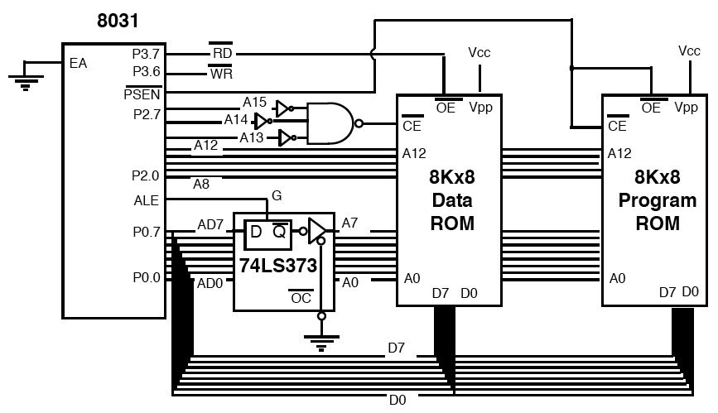
SECTION 14.4: 8051 DATA MEMORY SPACE
MOVX instruction
Figure 14–14
8031 Connection to External Data ROM and External Program ROM
vignan university

Slide 36
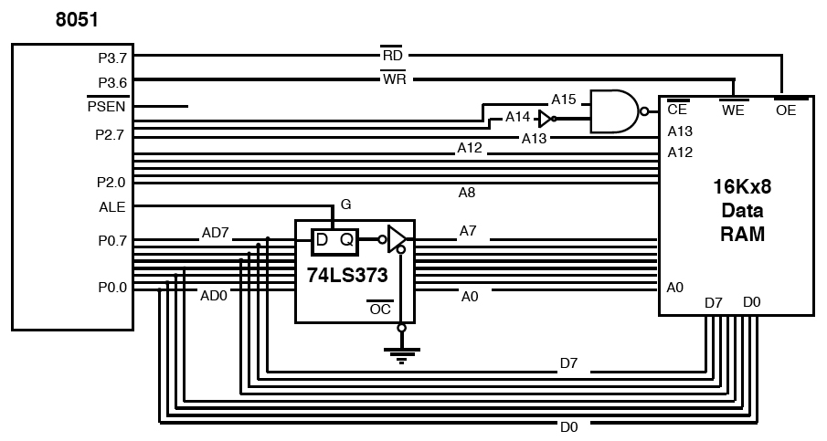
SECTION 14.4: 8051 DATA MEMORY SPACE
MOVX instruction for external RAM data
vignan university
Figure 14–15 8051 Connection to External Data RAM

Slide 37
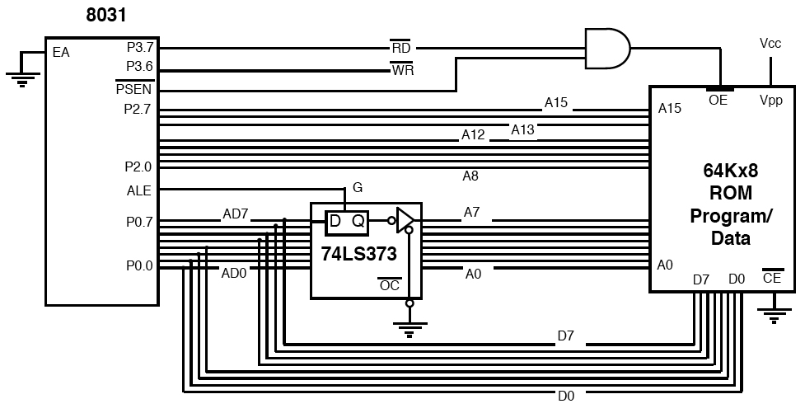
SECTION 14.4: 8051 DATA MEMORY SPACE
A single external ROM for code and data
vignan university
Figure 14–16 A Single ROM for Both Program and Data

Slide 38
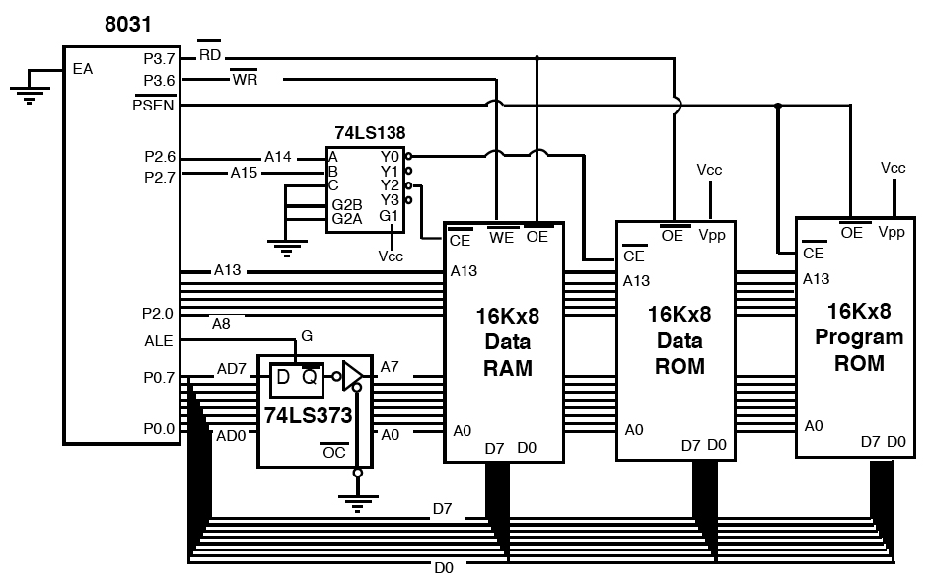
SECTION 14.4: 8051 DATA MEMORY SPACE
8031 system with ROM and RAM
Figure 14–17
8031 Connection to External Program ROM, Data RAM, and Data ROM
vignan university

Slide 39
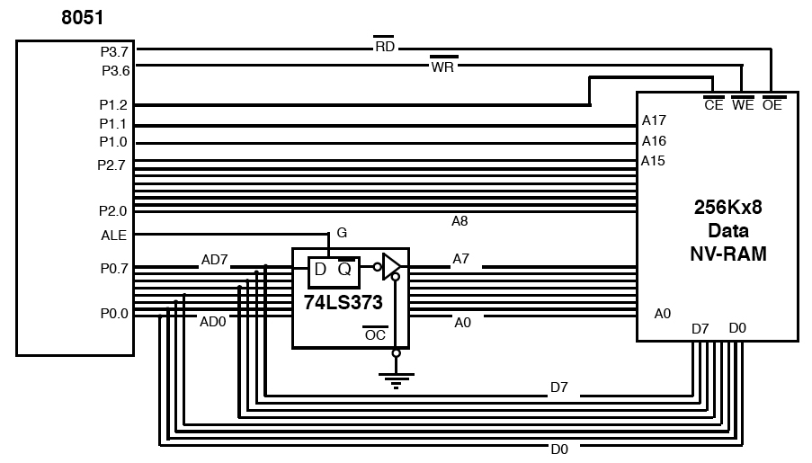
SECTION 14.4: 8051 DATA MEMORY SPACE
Interfacing to large external memory
vignan university
Figure 14–18 8051 Accessing 256Kx8 External NV-RAM

Slide 40
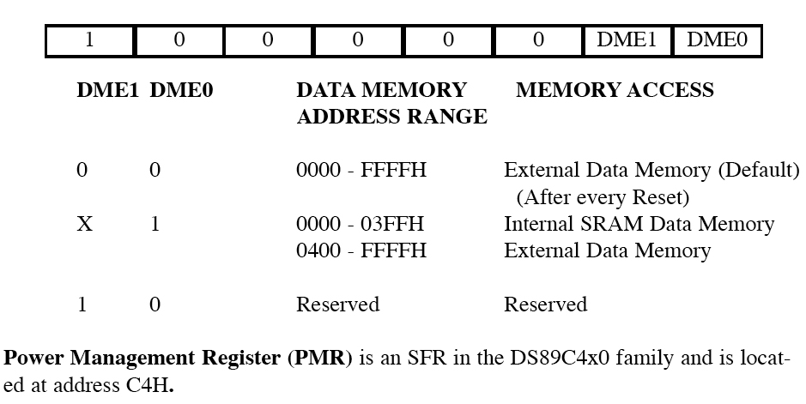
SECTION 14.4: 8051 DATA MEMORY SPACE
ACCESSING 1 K-BYTE SRAM IN ASSEMBLY
Figure 14–19 PMR Register Bits for 1K-byte SRAM of DS89C4x0 Chip
vignan university

Slide 41
Next …
Lecture Problems Textbook Chapter 11
  Answer as many questions as you can and submit via MeL before the end of the lecture.
vignan university

